Slide 1
Walmart Sales

Slide 2
Contents
Infer
Outliers
Models
Conclusion

Slide 3
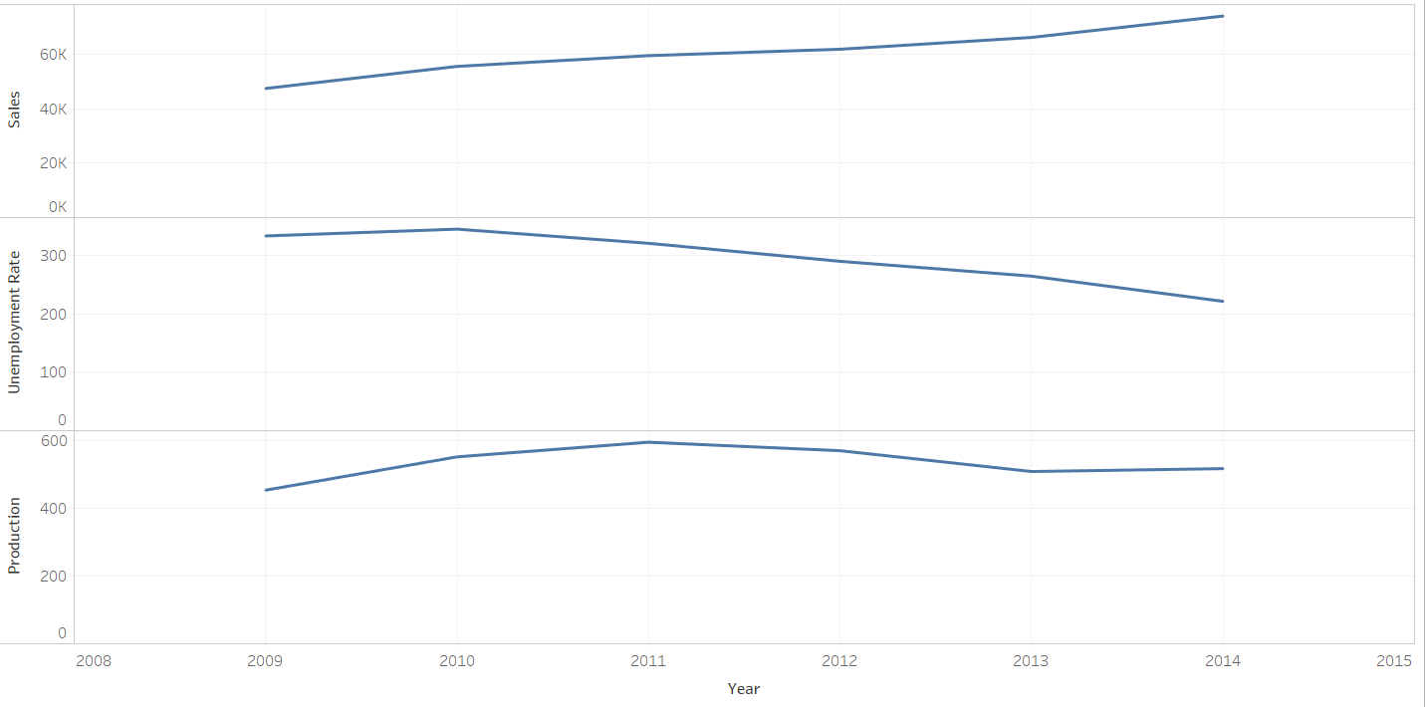
As Unemployment decreasing sales are increases

Slide 4
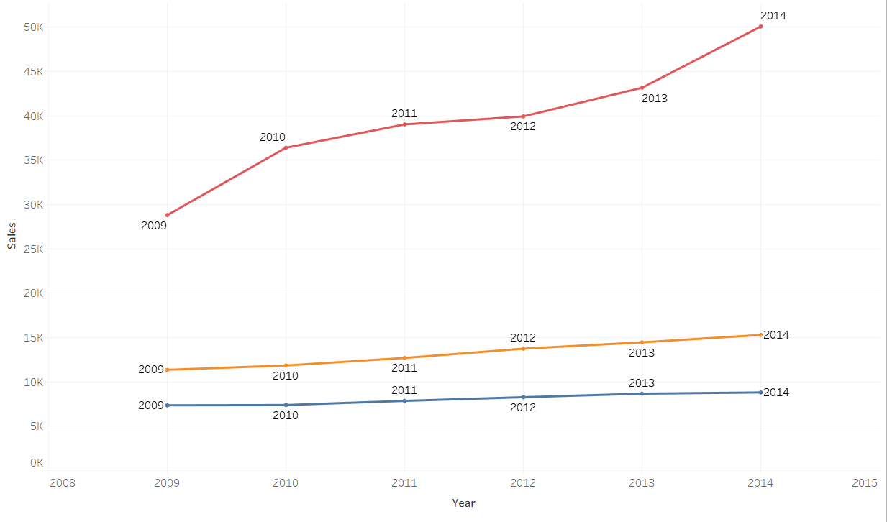
Best example of women do more shopping

Slide 5
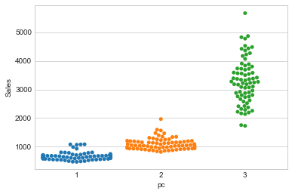
Why women has more sales???

Slide 6
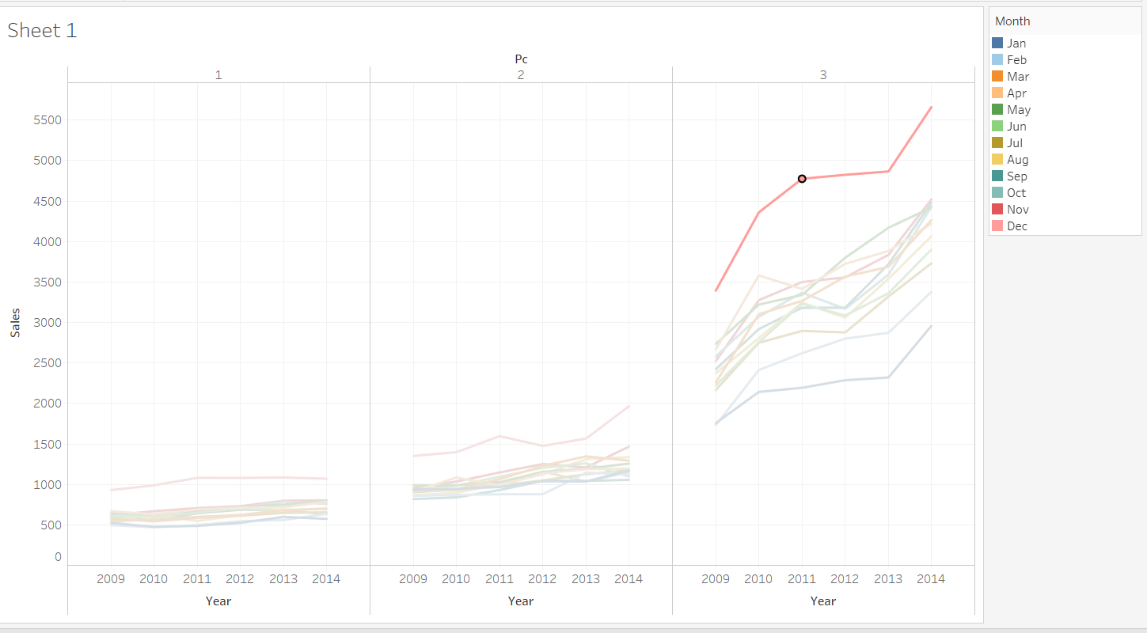
In the December has more sales

Slide 7
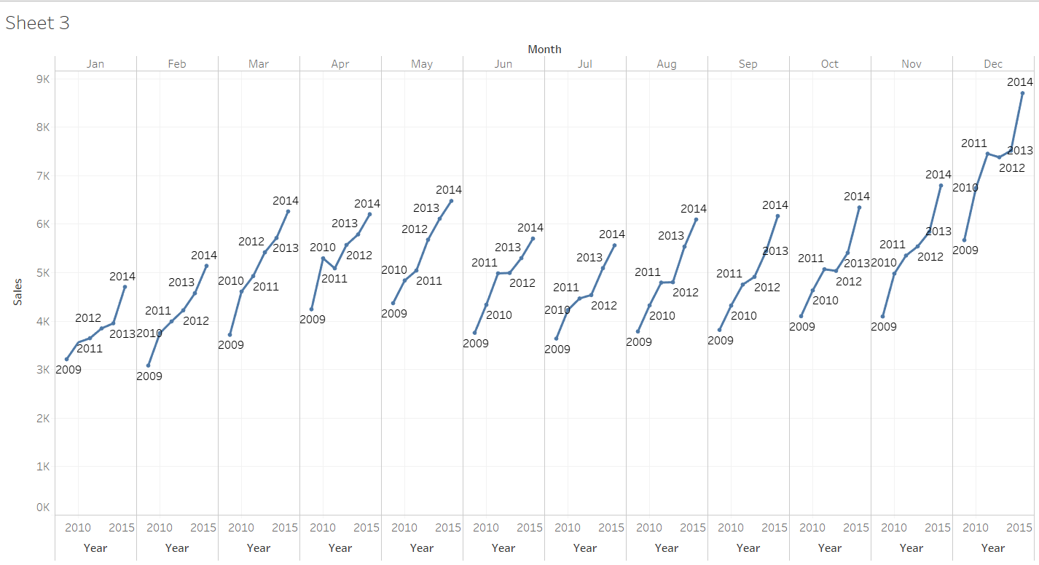

Slide 8

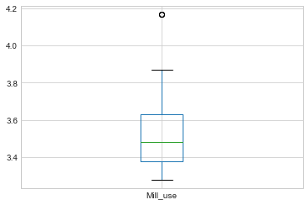
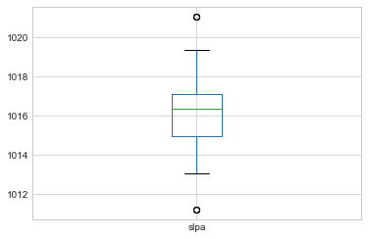
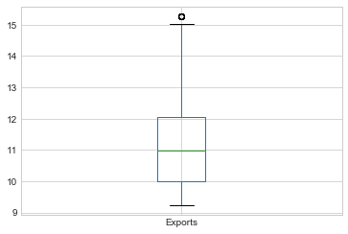
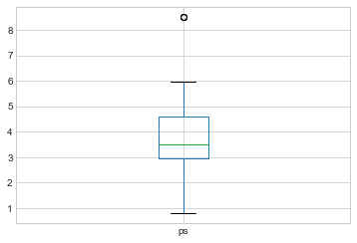
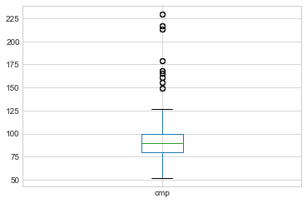
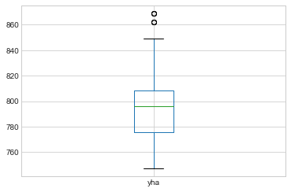

Slide 9
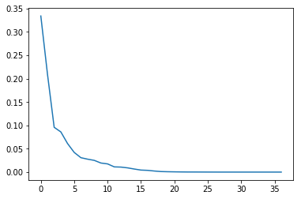
PCA

Slide 10
Models
Model Without PCA | RMSE
Forest Regressor(Only for Train data) | 630
Decision Tree | 690
Knn | 730
Navie Bayes | 930
With PCA
Forest Regressor | 882
Decision Tree | 998
Knn | 732
Navie Bayes | 845

Slide 11
Thank You

